Slide 1

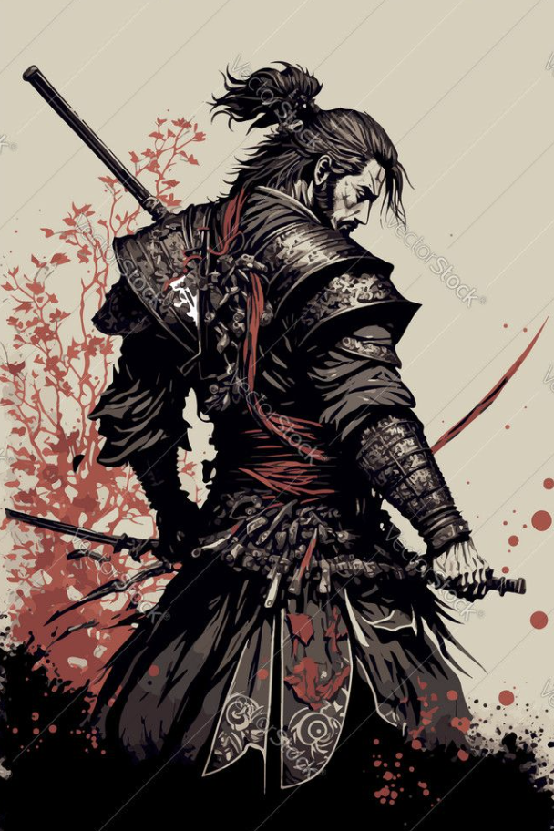
Honorifics（Topic 2）
& My Samurai Day（Activity 3）
Mr. Z
Nov 16th 2025

Slide 2

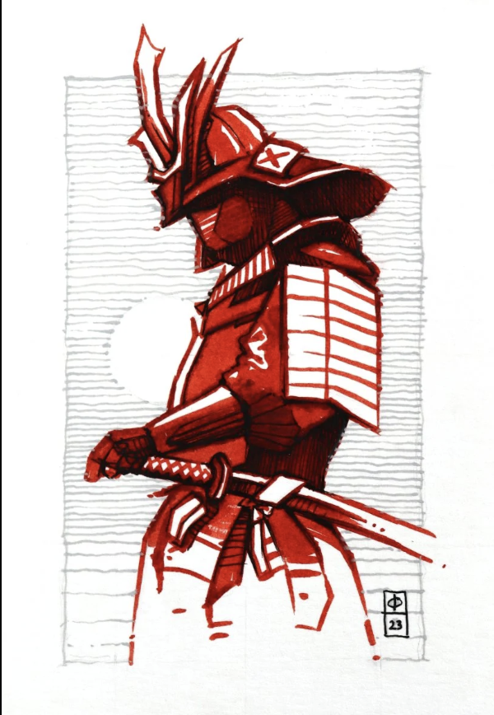
01
Honorifics & Respect (Topic 2 10 mins)
02
My Samurai Day (Activity 3 5 mins)

Slide 3

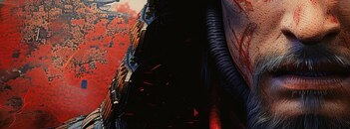
Honorifics & Respect in Samurai Society
Understanding Japanese Social Hierarchy
In Japanese, honorifics are more than just polite words; they are a mirror of the samurai era. This system dictated who spoke how to whom, making the understanding of status and respect
Time: 10 minutes

Slide 4
Japanese Social Structure & Honorifics
天皇 (Tennō)
将軍 (Shōgun)
大名 (Daimyō)
武士 (Bushi)
友達
Emperor
Shogun
Lords
Samurai
Friends
～さま (sama)
～殿 (dono)
～殿 (dono)
～さん (san)
～君 (kun)
Visualize the hierarchy: the higher the status, the more formal and unique the honorific.

Slide 5
Listen to the Difference!
Example 1: Meeting the Emperor (Very Formal)
Example 2: Meeting a Friend (Casual)
太郎君、練習しよう。
天皇さま、お会いできて光栄です。
"Taro, let's practice."
"Emperor, it's an honor to meet you."

Slide 6
Match the Honorific!
Type the correct honorific in the chat. You have 30 seconds for each scenario!
Round 1: You meet the Emperor.
Correct answer: さま (sama) - Example: 天皇さま、こんにちは。
Round 2: Your samurai friend arrives.
Correct answer: 君 (kun) - Example: 太郎君、元気？
Round 3: Reporting to the Daimyo.
Correct answer: 殿 (dono) - Example: 大名殿、ご報告します。

Slide 7
Create Your Honorific Guide
Choose one option and start creating!
Option A: Paper or Digital Cards
Option B: Role-play Video
Create 4 cards on Paper Infront or Jamboard. Each card should have:
Record a 30-second selfie video (don’t upload):
A person (e.g., 君)
Their honorific (e.g., せんせい)
A greeting (e.g., "先生、おはようございます")
Show 2 different honorific situations
No editing needed, direct upload
Use your phone or webcam
Time: 2 minutes
Be creative!

Slide 8
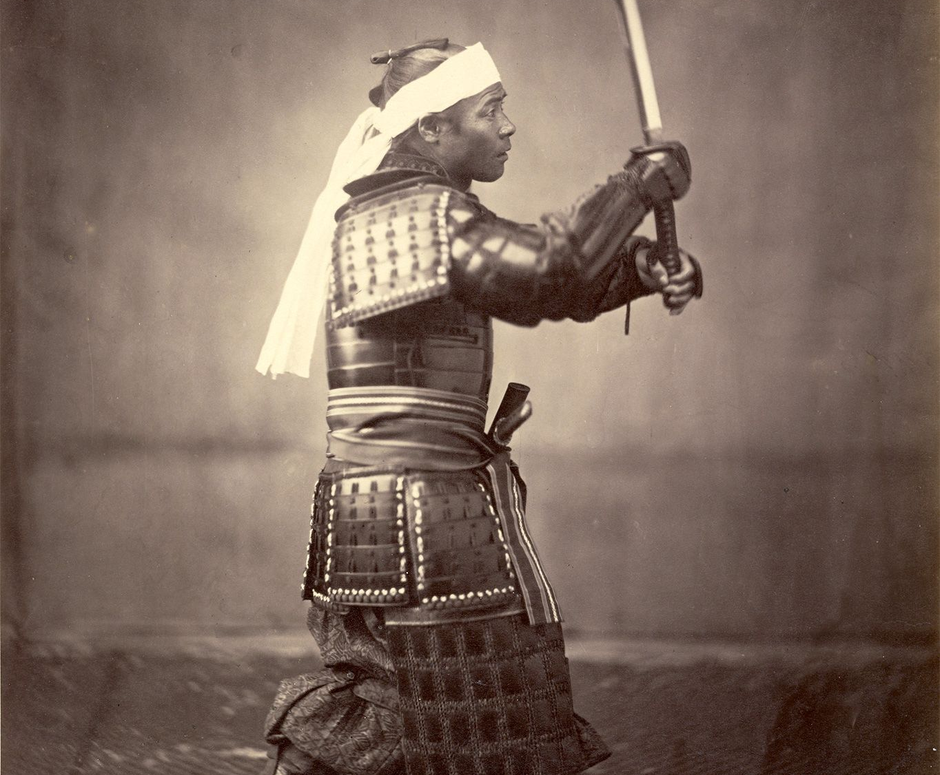
My Day as a Samurai
5-Minute Multimodal Creation
Step into the sandals of a samurai and narrate your day! Use Japanese verbs and at least one honorific to bring your story to life.
Create
Share

Slide 9
Choose Your Mission Level!
🟢 Option A: Samurai Schedule
Create a simple timetable on paper or in Google Docs. Include 5 verbs, 5 emojis, and 1 honorific.
🟡 Option B: Samurai Selfie Video
Record a 1-minute selfie video (don’t upload) showing 3 actions and saying 3 Japanese sentences. No editing needed!
🔴 Option C: Digital Poster
Use a Canva template. Add your samurai name, 4 daily activities, 2 honorific sentences, and a motto.

Slide 10
Create Your Samurai Day!
Your Samurai Creation Checklist:
Choose your option
4:00
Include vocabulary from today
Add at least one honorific
Be creative!
Focus on creation, not perfection!
Ready to share

Slide 11
Samurai Showcase!
Sharing Options:
Emoji Reactions:
Screen share your work
Strong warrior!
Great Japanese!
Post link in chat
Well done!
Creative!
Upload to Padlet
Every attempt is a victory worth celebrating!

Slide 12

Today's Samurai Journey Complete!
What We Learned:
Japanese honorifics (さま、殿、さん、君)
Social hierarchy understanding
Created multimodal samurai content
Digital Tools Used:
Jamboard, Google Docs, Canva, Phone camera
Next Lesson Preview:
"Samurai legacy"

