Slide 1
The First Three Unit Answers

Slide 2
W1 Preparation for Week 1 Pedagogy and the Quality Teaching Model
Task 1: How QTM Enhances My Teaching Skills
Self-reflection Framework: Through QTM, I can reflect on specific teaching activities or objectives
Key Questions: "What am I actually doing right now? Why am I doing this?"
Classification Function: Categorize entire teaching implementation from a purpose level, making teaching more organized
Task 2: Flexible Alignment of Learning Design with QTM Dimensions
Multi-dimensional Alignment Phenomenon: When designing activities, they often involve both Deep Knowledge and Cultural Significance simultaneously
My Handling Strategies:
  Method 1: Divide the activity into two parts, each corresponding to one dimension
  Method 2: Classify according to QTM dimensions based on the activity's main emphasis

Slide 3
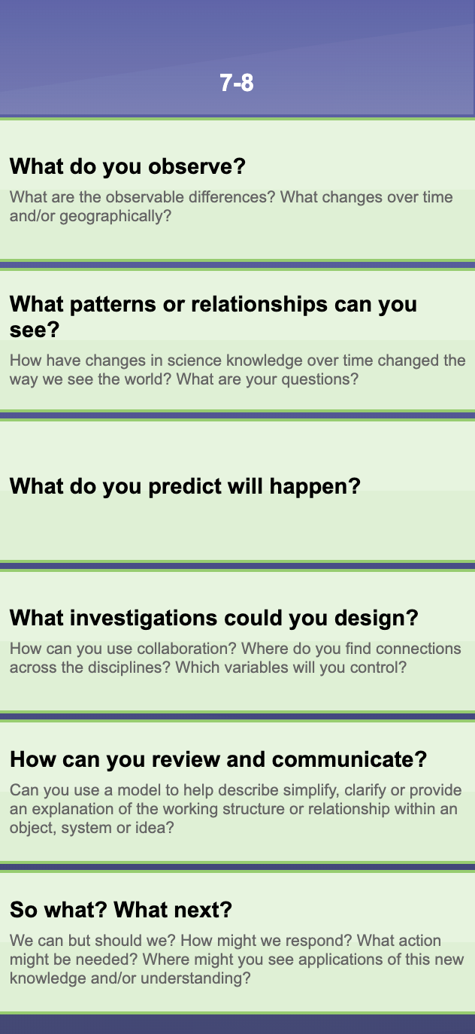
Module 2A: Week 2: Preparation and Planning to teach/ aligning the elements
Task 1: Observation of Naracoorte High School Music Programming Case
Observed Teaching Methods:
  Project-based learning built on students' musical interests
  Technology integration using Scratch2 and Incredibox
My Selected QTM Element Alignments:
  Student Engagement: Leveraging students' confidence as "competent music judges," combining personal music taste with programming
  Substantive Communication: Complex code interfaces show deep technical exchange, teacher-student discussions about roles and enthusiasm
Task 2: Application of "What do you observe?" Strategy Framework
Value of Layered Observation Method: Not just a quick look, but guiding deep observation
Progressive Nature of Questioning Tools:
  Basic: "What do you see/hear/smell?"
  Analysis: "What features are same/different?"
  Deep: "What is surprising/unexpected?"
Tools Extending Senses: Microscopes, thermometers, etc. make observation more comprehensive

Slide 4
Module 2B: Week 3: Strengthening Pedagogy through Peer Observation and Feedback
Task 1: Key Moments in Peer Feedback
Importance of "Aha Moments":
  Students suddenly realize concept importance, expressions change, engagement increases
  Successfully connecting new content with prior knowledge, helping them see relevance
Energy Activation through "Playbooklet Activity":
  Gamified elements immediately energize students and foster collaboration
  Not only re-energizes classroom but creates positive atmosphere through interaction
Task 2: Critical Examination of My Teaching Practice
Improving "Conceptual Delivery Confusion":
  Problem: Students confused when using inquiry approach to explain concept of difference
  Solution: Pause → Board example → Invite students to restate in their own words
Rhythm Adjustment for "Physical Exhaustion":
  Problem: Too much lecture time, students lying down or losing focus
  Solution: Quick pair discussions → Short movement break → Re-activate attention

