Slide 1

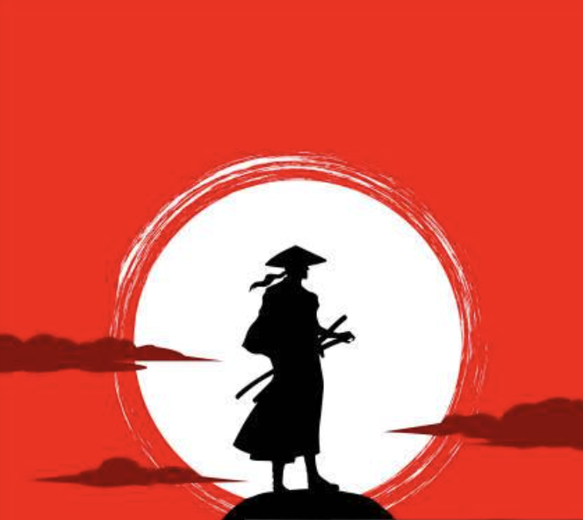
Mr. Z’s
The World of Samurai
Lesson 1
Topic 2 & Activity 3 (15 mins)
Oct 19th, 2025

Slide 2

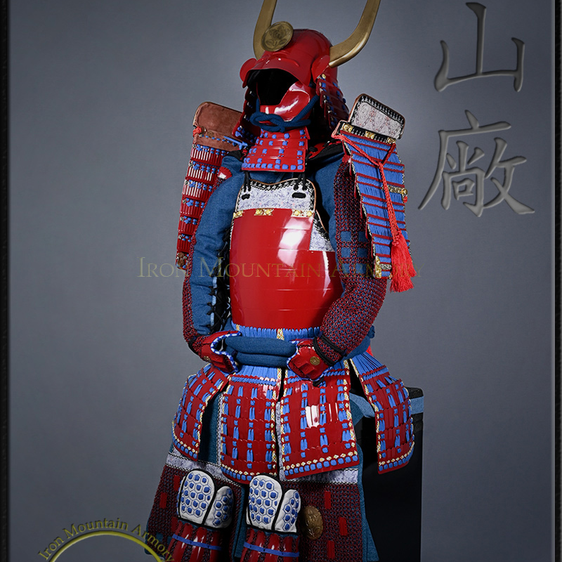
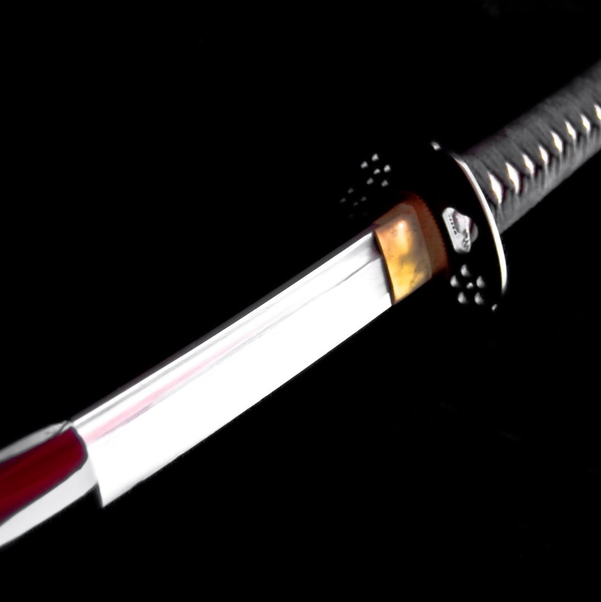

Topic 2 (10 mins) Grammar
〜は〜です
(wa ~ desu) = "... is ..."
Note: "は" is pronounced "wa" (topic marker)
武士は戦士です
かたなは武器です
武士は強いです
Samurai is a warrior
Katana is a weapon
Samurai is strong

Slide 3
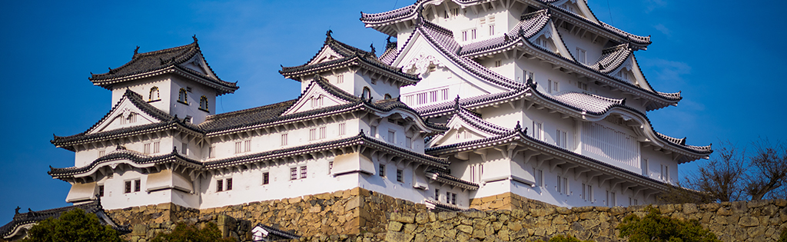
Samurai History 武士の歴史
Timeline
Social Hierarchy
1185
1868 CE
天皇 てんのう Emperor
700 years
↓
将軍 しょうぐん Shogun
↓
大名 だいみょう Daimyo
↓
武士 ぶし SAMURAI ⭐
What did samurai do?
⚔️ Protect lords (大名を守る)
🏯 Fight battles (戦う)
📜 Follow bushido (武士道)
🎭 Cultural symbols of honor, loyalty, discipline

Slide 4
Let's Practice! 練習しましょう!
武士は...?
→
戦士です!
武士は強いです!
かたなは 武器 です!
すごい! Excellent! 素晴らしい!

Slide 5
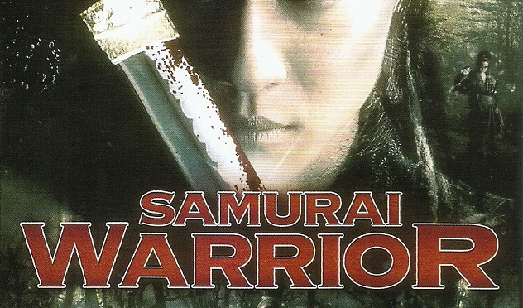
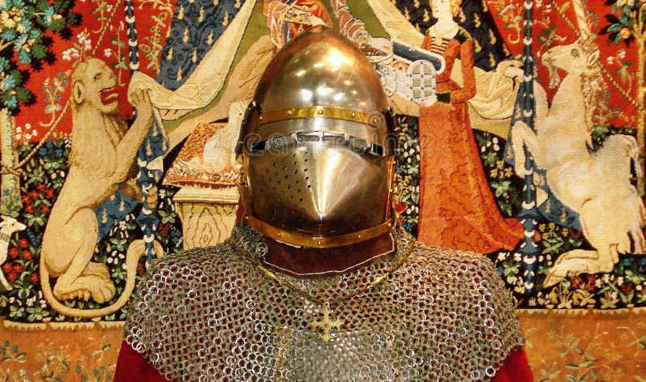
Activity 3 (5 mins) Samurai 武士 vs Knights 騎士
Samurai 武士 ぶし
Knights 騎士 きし
📋 TASK (3 minutes)
Use: 武士は____です / 騎士は____です
Venn Diagram
Quick Venn Template
Join Breakout Room (3-4 students)
Open Jamboard link (in chat)
Make Venn Diagram
SAMURAI
武士
BOTH
両方
KNIGHTS
騎士
✅ 3 samurai features (IN JAPANESE IF YOU CAN)
✅ 3 knight features (IN JAPANESE IF YOU CAN)
Different
Similar
Different
✅ 2 similarities

Slide 6
Great Work Today! お疲れ様でした!
Key Learning:
"Samurai and knights were both warriors with honor codes, but their CULTURES were very different."
Language helps us understand cultural differences!
Today we learned:
Next Lesson's Preview:
Sentence pattern 〜は〜です
Samurai history (1185-1868)
Bushido philosophy: values, virtues
Samurai role & values
Cultural comparison

