Slide 1
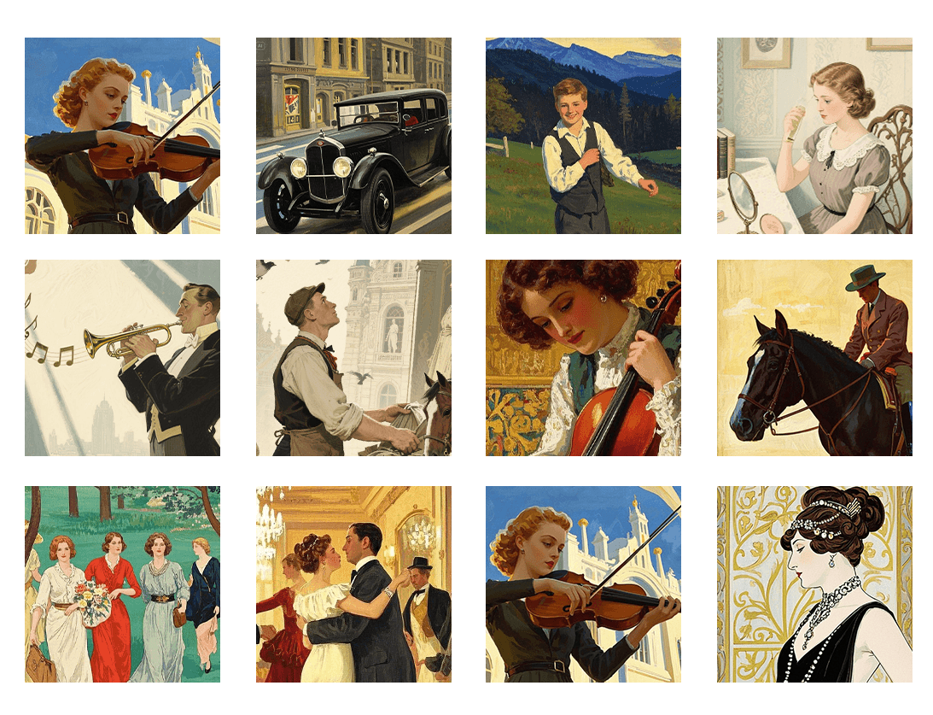

Samurai Word Association Time Machine
Kimi AI
2025/05/01

Slide 2

Activity 1: Word Association
Activity 2: Detective Stations
Wrap-Up & Assessment

Slide 3
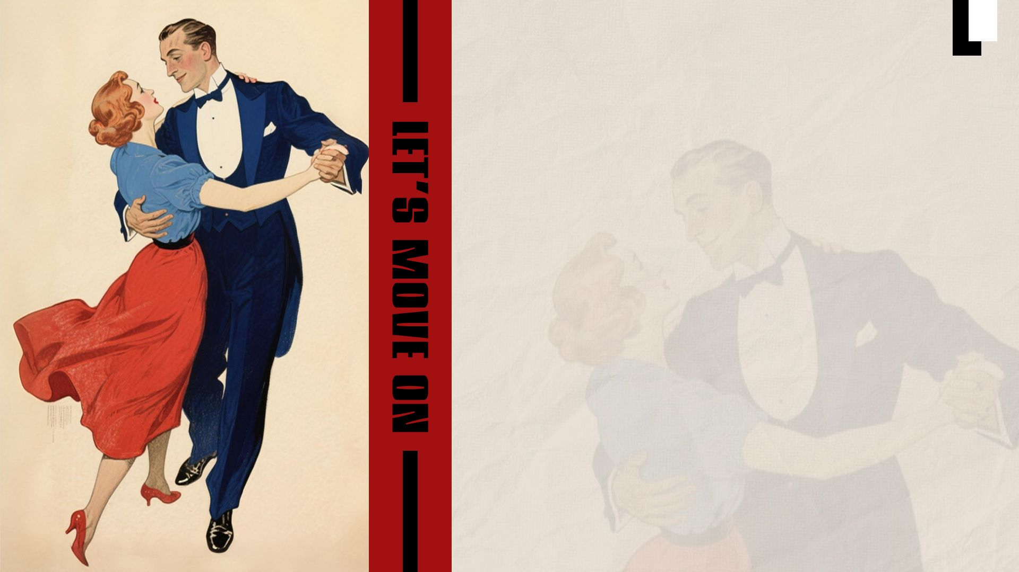
CHAPTER.01
Activity 1: Word Association

Slide 4

You Are Time Travelers Today!
Journey from 1603 to 2024 to explore the transformation of samurai culture.
3 Quick Missions
Shape the Data
5 Minutes Total
Complete word storm, sorting, and voting challenges.
Every word you type influences our live results.
Fast-paced, fun, and full of discoveries.

Slide 5
Rapid Word Storm: Sixty Seconds!
Quick! What comes to mind? Don't overthink it!
Traditional Samurai
Modern Anime Samurai
sword
armor
serious
honor
cool
power
friends
magic
speed
discipline
Type 3 words. Examples: sword, armor, serious.
Type 3 words. Examples: cool, power, friends.
Time Remaining: 00:60

Slide 6
Our Collective Mind Map
Observe the patterns in our class's words. What do you notice?
SWORD
HONOR
LOYALTY
COOL
POWER
FRIENDS
MAGIC
DISCIPLINE
BUSHIDO
ARMOR
KATANA
SPEED
ANIME
HERO
ENERGY
RESPECT
Word size reflects how often it was mentioned by the class.

Slide 7
Interactive Venn Diagram
Sort the concepts! Drag each word to where you think it belongs.
BOTH
Modern Only
Traditional Only
Sword / 刀
Honor / 名誉
Anime / アニメ
Friends / 友達

Slide 8
Let's Check Our Sorting!
Traditional Only
Both (Shared)
Modern Only
Seppuku (ritual suicide)
Sword / 刀
Anime / アニメ style
Rigid social hierarchy
Honor / 名誉
Special powers
Samurai class system
Loyalty / 忠誠
School settings
Training / 修行
Friendship themes
Reflection: Why do some elements persist while others change? What does this tell us about core values versus historical context?

Slide 9



What Do You Think?
Modern anime/game samurai are...
📜 Accurate Preservation
🎨 Creative Reimagining
❌ Cultural Misunderstanding
Keeping traditions alive faithfully.
Respectful but modernized adaptations.
Incorrect stereotypes or errors.
Click to vote and see real-time results!

Slide 10
Our Class Perspective
25%
60%
15%
Accurate
Creative
Misunderstanding
Top Student Comments
"It keeps the spirit but changes the look to be more appealing."
"It makes the samurai concept interesting for young people today."
"Sometimes it's too exaggerated and not realistic, which can be misleading."
But how do we know what's "real" vs "imagined"? Let's investigate!

Slide 11
CHAPTER.02
Activity 2: Detective Stations

Slide 12
Cultural Detective Investigation
3 Crime Scenes... I Mean, Research Stations!
Station 1
Station 2
Station 3
Authenticity Sorting
Language Building
Argument Builder
Collect a badge at each station! 15 minutes total.

Slide 13
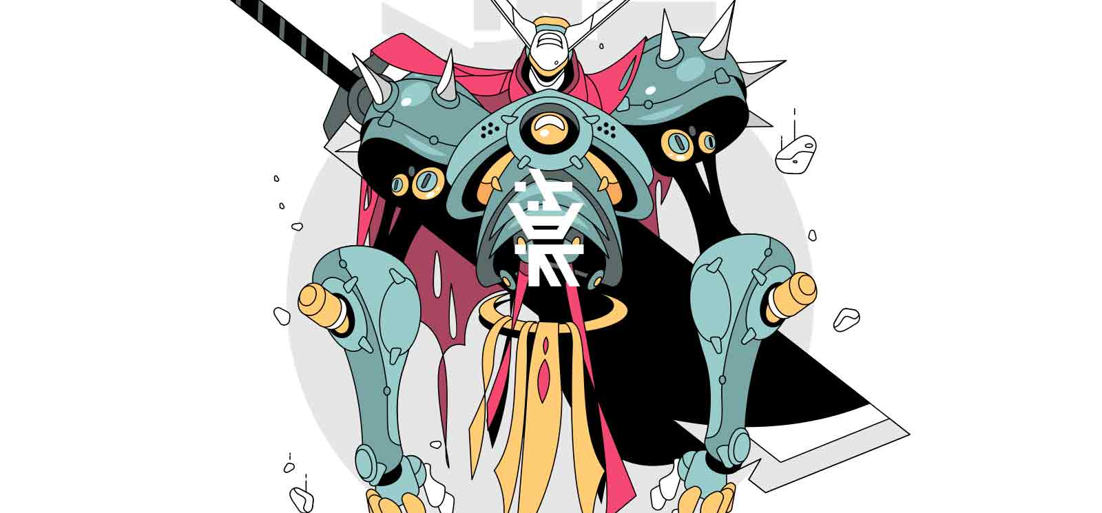
Station 1: Authenticity Sorting
Your Task: Sort 20 cultural elements into the correct boxes. Get 10+ correct to earn your badge!
Authentic Tradition: Really existed in history.
Creative Adaptation: Respectfully modernized.
Drag the cards to the correct category!
Cultural Misunderstanding: Errors or stereotypes.
Instant feedback will guide you.

Slide 14
What We Learned at Station 1
Authentic Elements
Creative Adaptations
Common Misunderstandings
Swords (katana) & armor
Honor code (bushido)
Loyalty to master
Meditation practices
Female samurai warriors
Breathing techniques
Visual effects (e.g., GoT)
Modern settings
Enhanced speed/strength
Dramatized duels
Samurai = Ninja
All samurai were men
They could fly/had magic
Fought constantly
Wore armor daily
Achievement: 🏆 Authenticity Expert Badge Earned!

Slide 15
Station 2: Language Building
Your Task: Build 3 comparative sentences using the templates and word bank.
Traditional Word Bank
侍
刀
名誉
忠誠
武士道
Basic Template:
"Traditional samurai [action], but modern anime [action]."
Modern Word Bank
侍は＿＿＿、でもアニメは＿＿＿
アニメ
ゲーム
かっこいい
友達
パワー
Intermediate Template:
"Although [what changed], [what stayed same]."
＿＿＿変わったが、＿＿＿は変わらない
Goal: Create 3 sentences + record 1.

Slide 16
Share Your Sentences!
1. Record
2. Listen
3. Give Stars
Record your best sentence (10 sec).
Listen to a partner's sentence.
Award stars for clarity, comparison, and grammar.
Achievement: 🏆 Language Master Badge Earned!

Slide 17
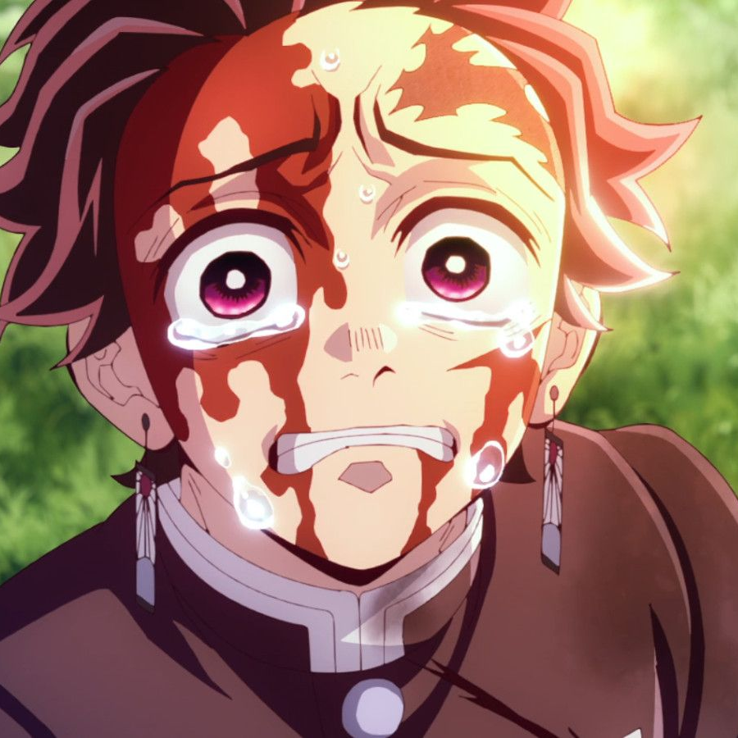
Station 3: Argument Builder
The Big Question: If Tanjiro time-traveled to the Edo period, would real samurai accept him?
Your Task:
Choose your stance (YES or NO).
Select 3 evidence cards that support your view.
Explain your reasoning to build a strong argument.
😊 YES
😐 NO

Slide 18
Our Class Debate Results
Stance Distribution
Most Popular Evidence
65%
"Protects the weak" - This aligns with the bushido code.
"Shows respect to opponents" - A core samurai value.
"Techniques too fantastical" - Not realistic for the era.
YES
35%
Reflection: What would ancient samurai think of our debate? What modern values guided our choices?
NO

Slide 19
CHAPTER.03
Wrap-Up & Assessment

Slide 20
Mission Complete!
🏆
🏆
🏆
Authenticity Expert
Language Master
Critical Thinker
Key Learnings from our journey:
Culture Evolves, but core values persist.
Modern Media Adapts tradition creatively.
Critical Thinking helps us understand change.
Exit Question: What surprised you most about samurai evolution?

Slide 21
Your Learning Progress
Individual Metrics
Class Achievements
Participation Rate: 95%
Total Words Generated: 156
Words Contributed: 12
Most Agreed Concept: Honor
Correct Sorting: 16/20
Strongest Argument: "Protects the weak"
Sentences Created: 3/3
Argument Strength: ⭐⭐⭐
Reflection Prompt: Rate your understanding of cultural evolution from 1-10.

Slide 22
