Slide 1


MSP ASSE A1
Mr. Z Samurai Unit
Jiacheng Richard Zou
Oct 29th 2025

Slide 2


Lesson 1 of the Unit 武士の世界 (The World of Samurai)
This Presentation is about this independent Language Unit, based on QTM model, facing into Year 8 Japanese Students. This Unite is going to highly engage students who is interested Japanese Culture, trigger their interests in Japanese Learning, and Highly Standard (can be simplified in enact, and implanted my own pedagogy (Full participation system)
Lesson 1: introduce to Samurai
Lesson 2: the ancient values of Samurai
Lesson 3: the daily life of samurai (with only simple extension to the Japanese honorific expression)
Lesson 4: to close, connect with modern culture and samurai Legacy
Let boys and girls to love it!
When they talk to their peers
”I learnt that on class! How does samurai speak!”
That would be very inner motivated for them to learn.

Slide 3






Strategy 1-2
Strategies 3-4
Strategies 5-6
Module Integration (M1 M2A M2B)
Conclusion

Slide 4
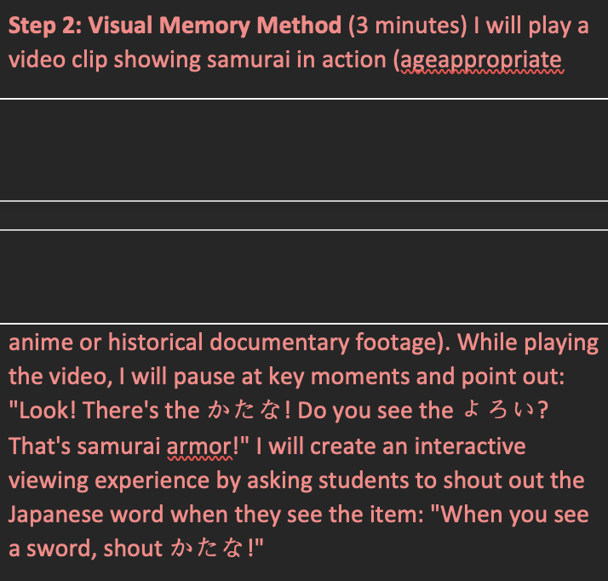
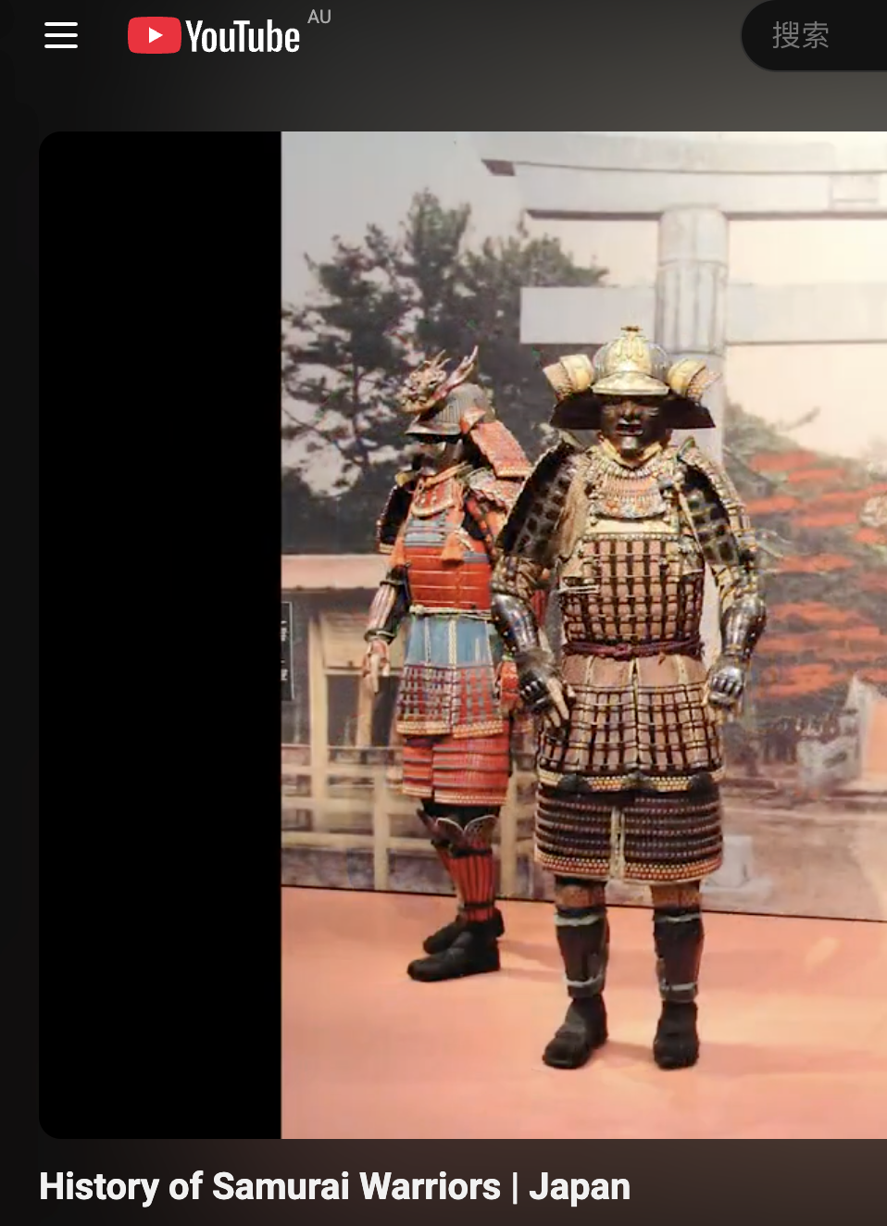
ST1：Learn Vocabulary in Context
QTM: Intellectual Quality
Important Point
Pause Video (Normally twice)
Work with whiteboard & Cards
Visual Memorization (especially work for Visual learner)
Trigger for the emotion
This method goes beyond simple memorization, constructing a deep conceptual understanding for young learners. It combines language learning with cultural context, which is the embodiment of the Gibbons language scaffolding theory in practice.
Gibbons, P. (2015). Scaffolding Language, Scaffolding Learning: Teaching English Language Learners in the Mainstream Classroom (2nd ed.). Portsmouth, NH: Heinemann.
Topic 1 Step 2

Slide 5
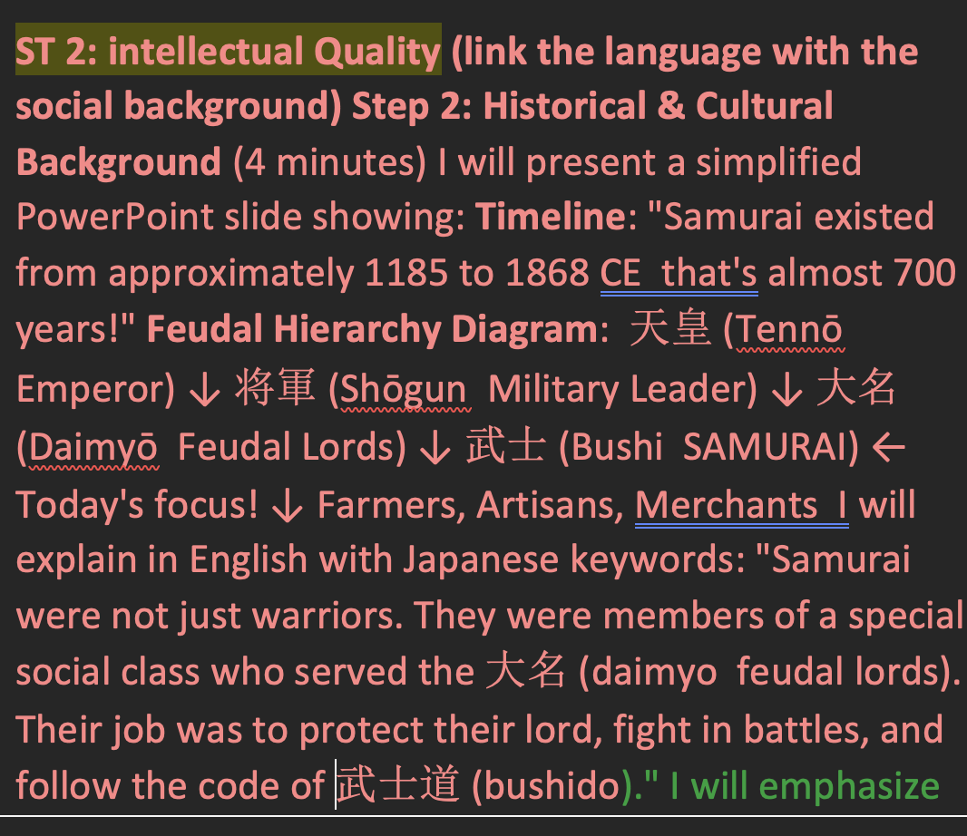
ST2：Social Hierarchy
QTM: Intellectual Quality
Through demonstration and graded illustration, embedding vocabulary teaching into the historical context structure, it promotes students' abstract thinking and cross-curricular understanding
Social Rank in Edo Period Japan (1185-1868 CE)
天皇 (Emperor)
将軍 (Shogun)
大名 (Daimyo)
武士 (Samurai)
農民/職人/商人
Topic 2 Step 2

Slide 6
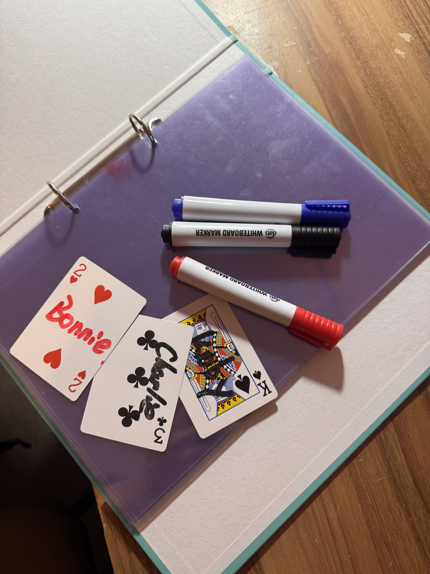
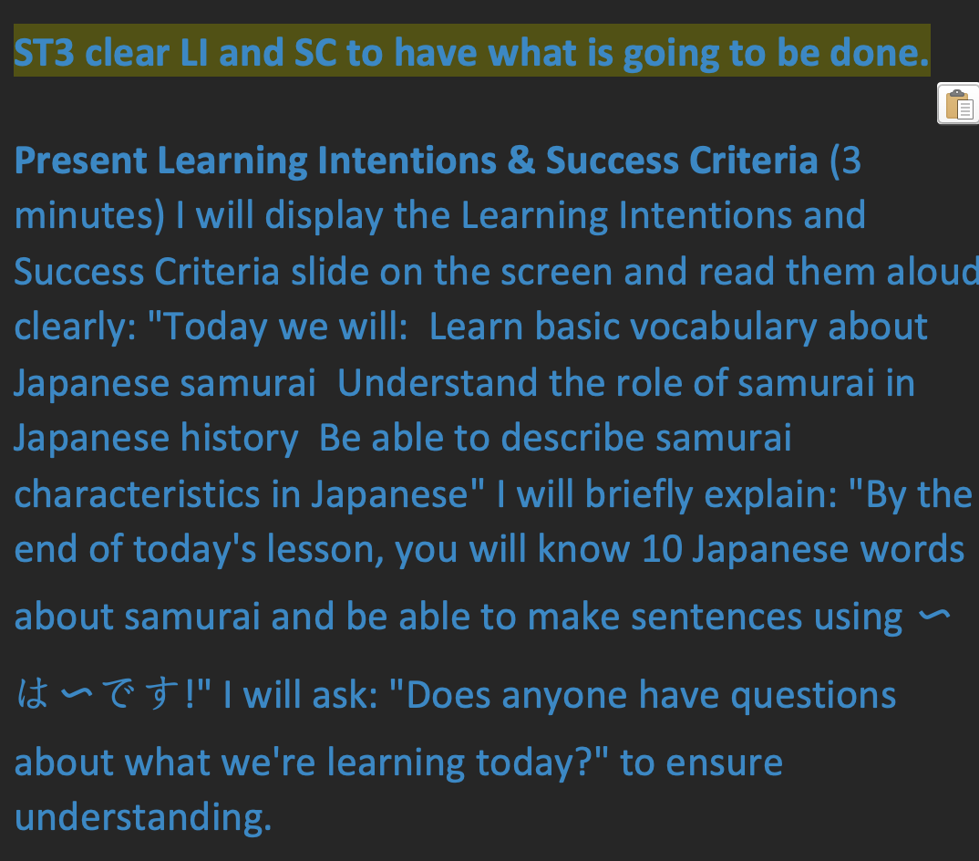
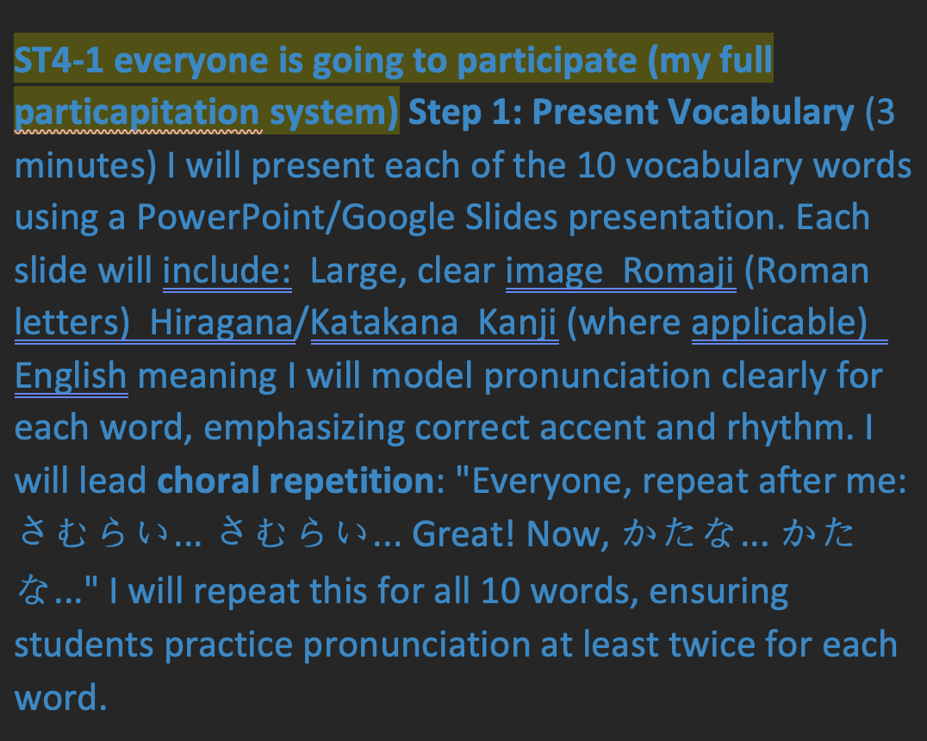
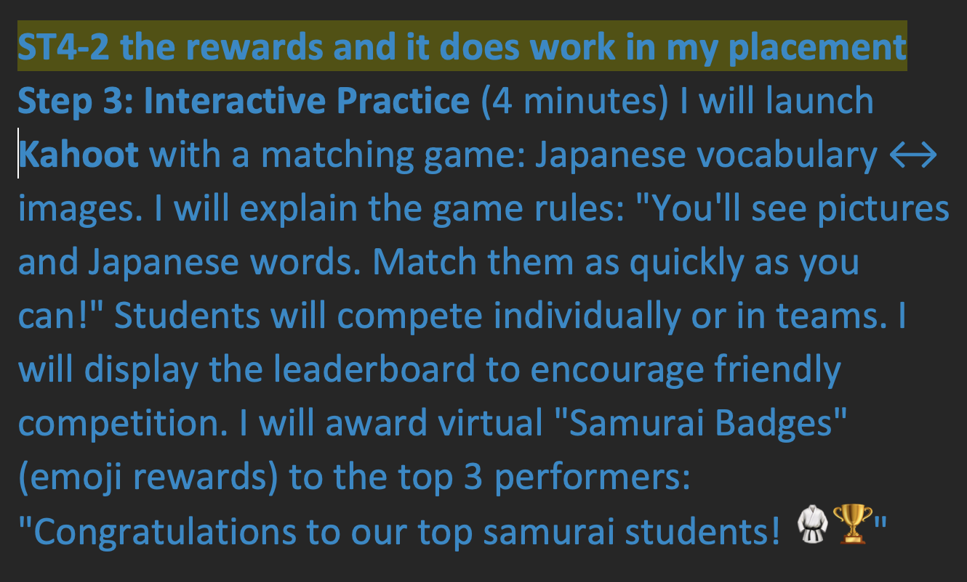
ST3 ST4-1 ST4-2：Quality Learning Environment
All Participants
Rewards
Through choral response to open and end class
And more focus on Success Criteria
Info Collection (My System)
Use Kahoot and give the student the first place or second place
Whiteboard or Online System
And card to call the name
Topic 1 Step 1& 3

Slide 7
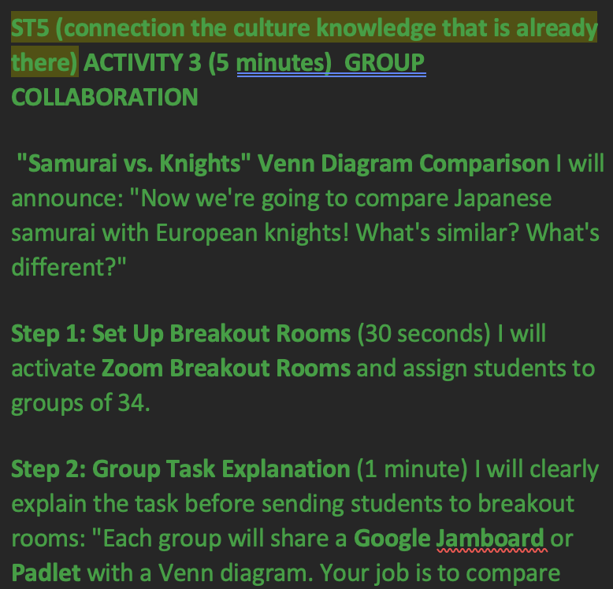
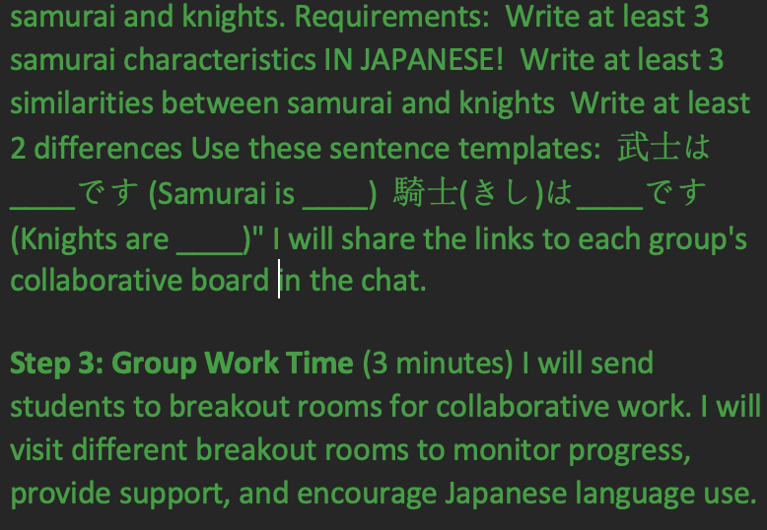
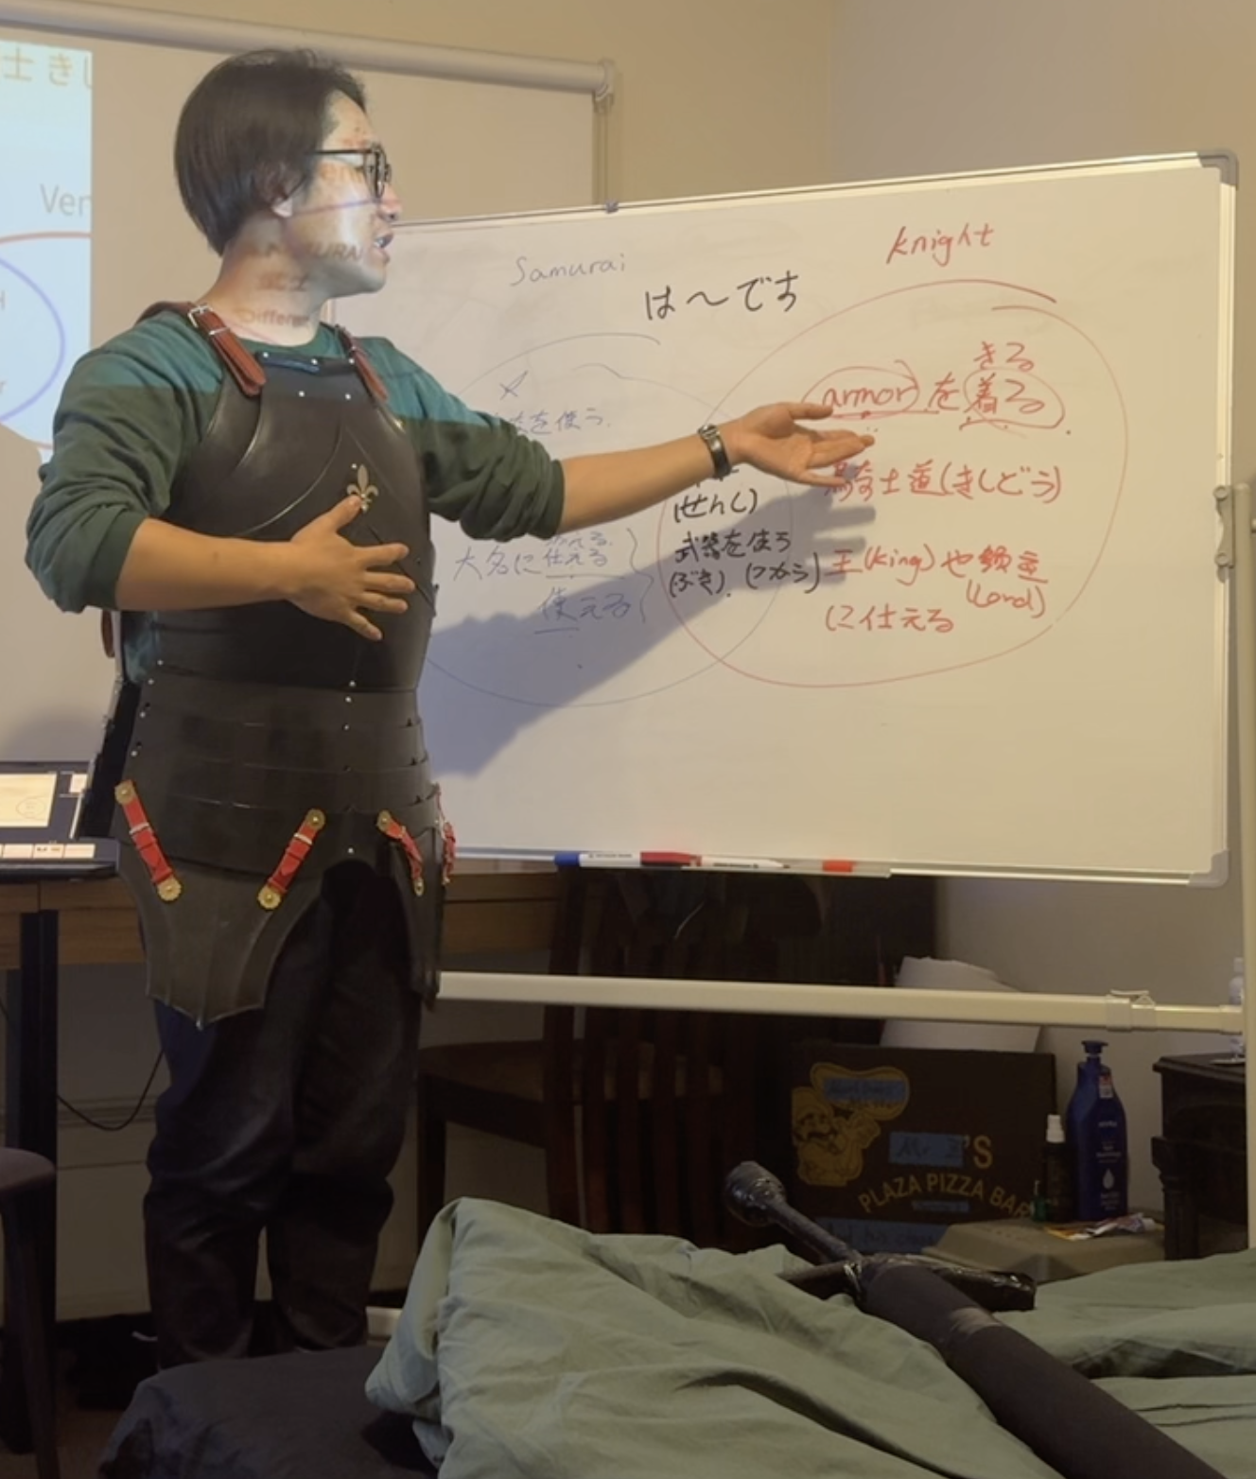
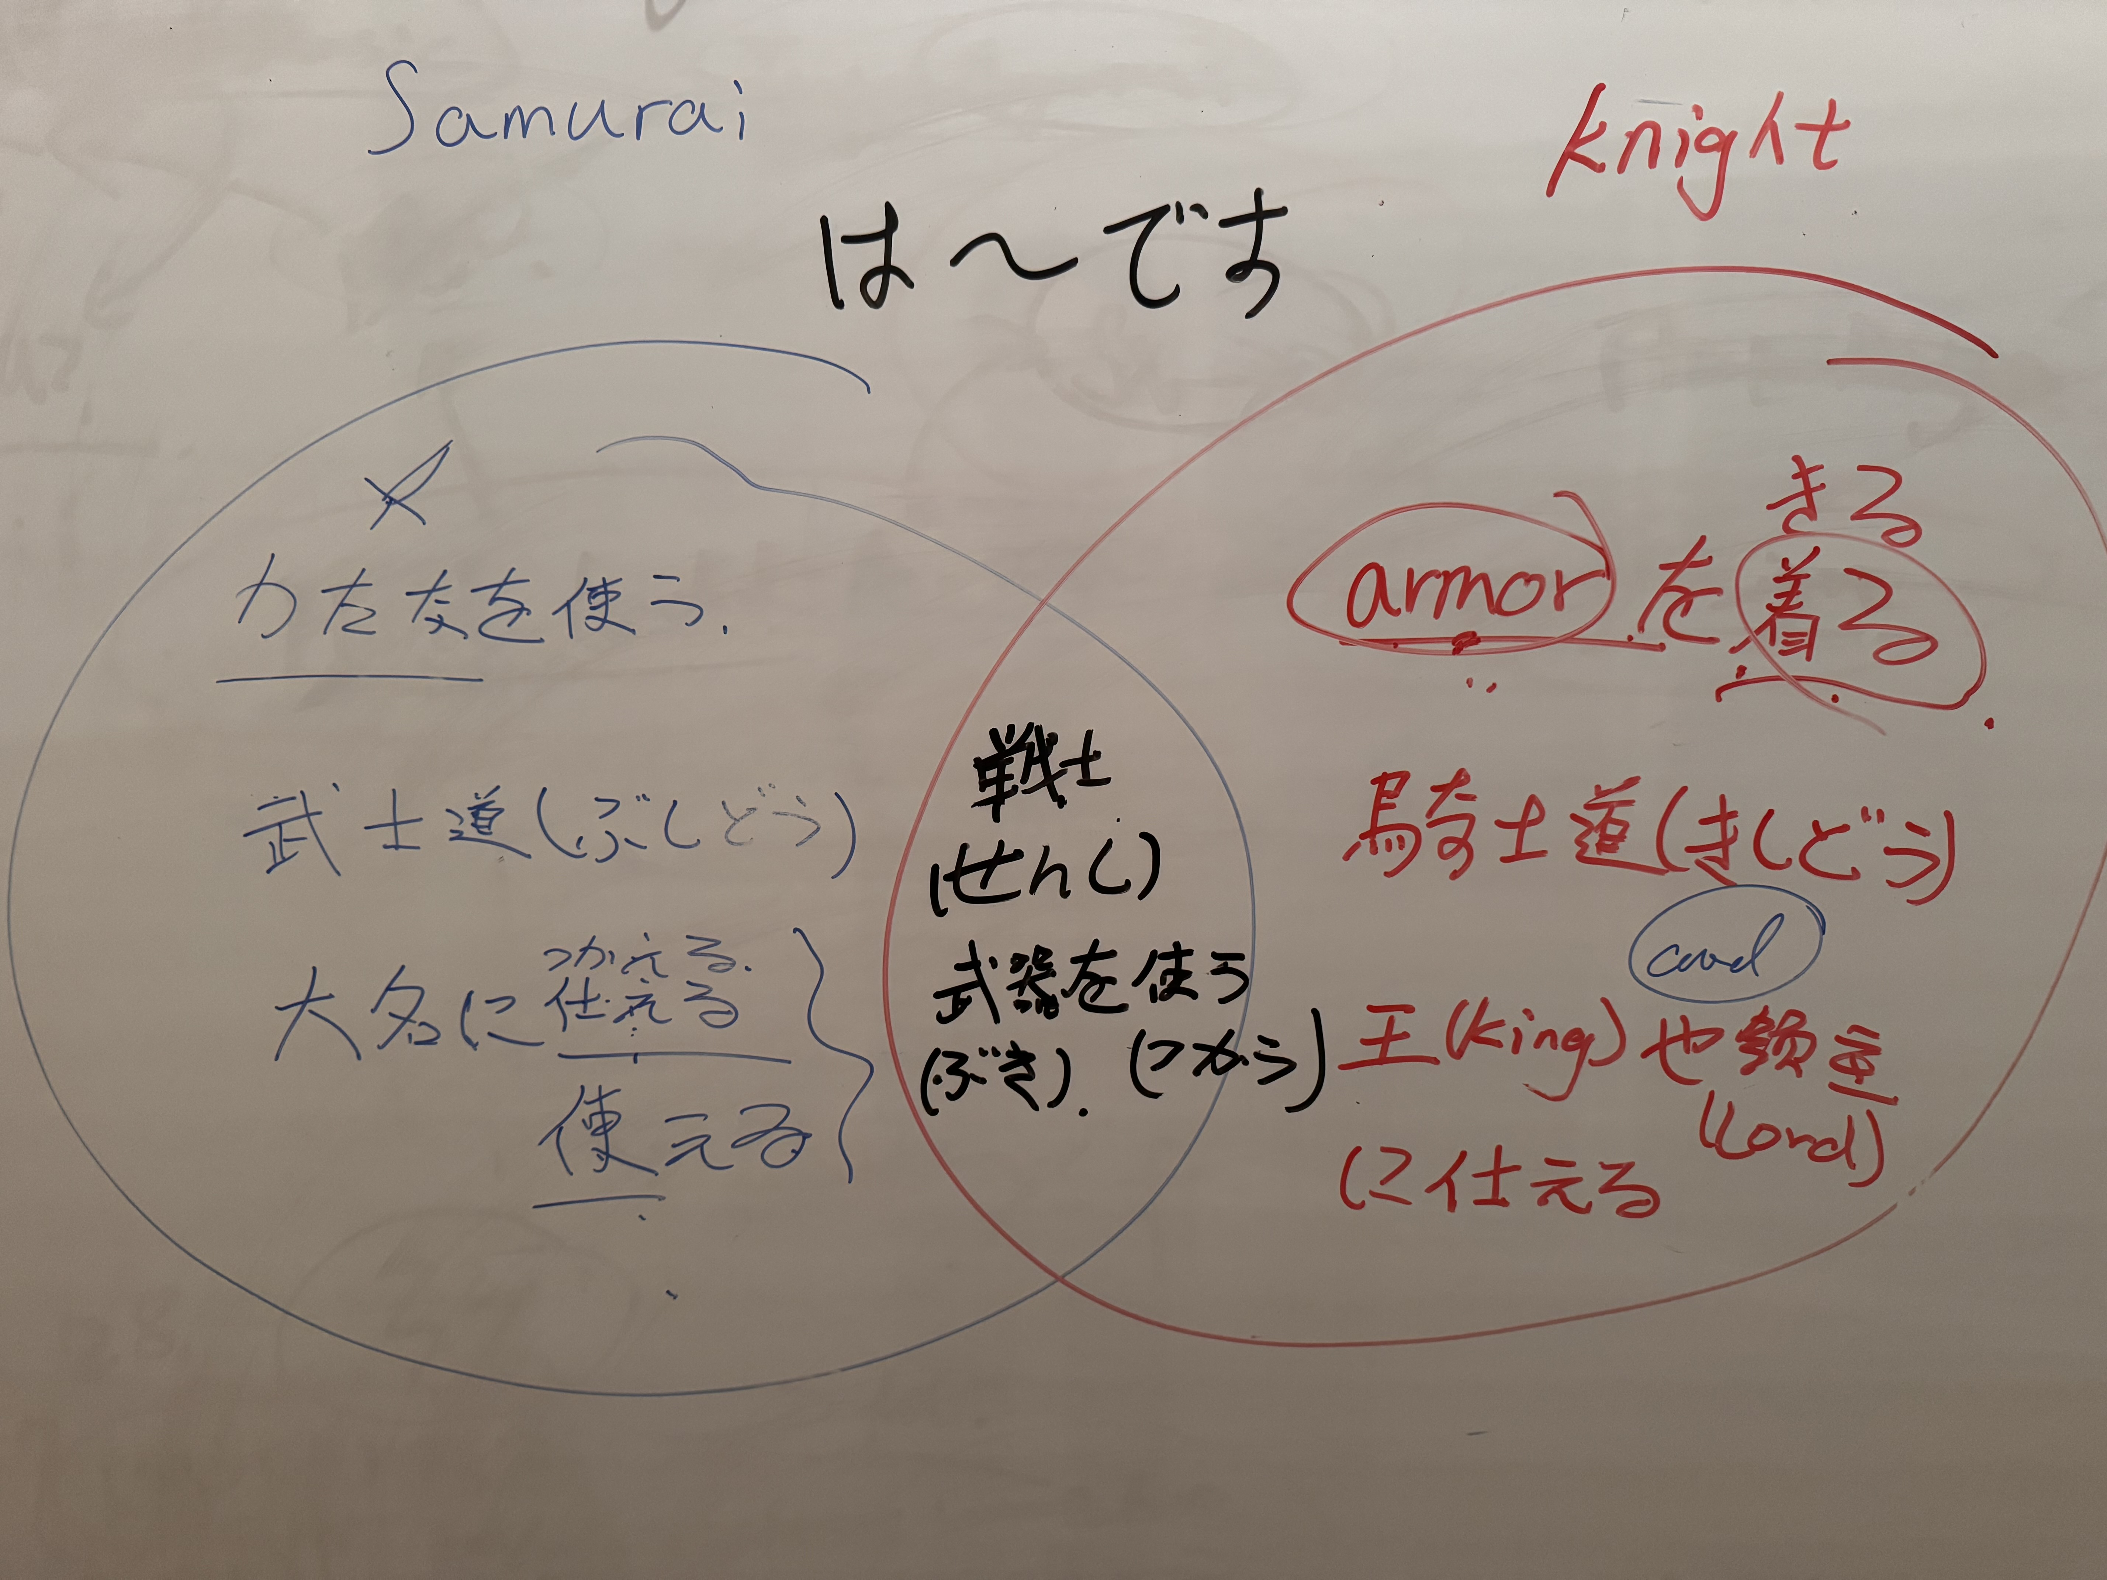
ST5: Significance Culture Knowledge (East and West)
QTM Element: Cultural Knowledge
Overview: A 5-minute collaborative activity where students compare Japanese samurai and European knights using Venn diagrams or comparison charts in breakout rooms.
Key Focus:
Cultural values (honor, loyalty, discipline)
Similarities and differences between warrior classes
Modern influences of historical traditions
Language Practice: Students use Japanese sentence templates to express comparisons while exploring how these historical figures shaped contemporary Eastern and Western cultures.
Goal: Build cross-cultural understanding through active comparison and critical thinking about warrior traditions in both civilizations.
Activity 3

Slide 8
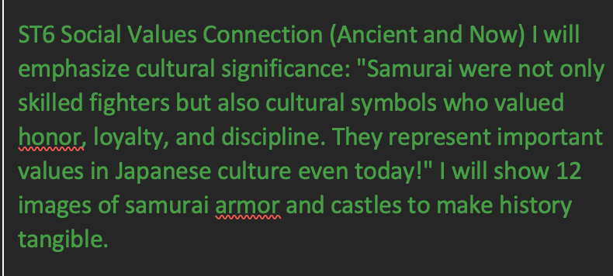
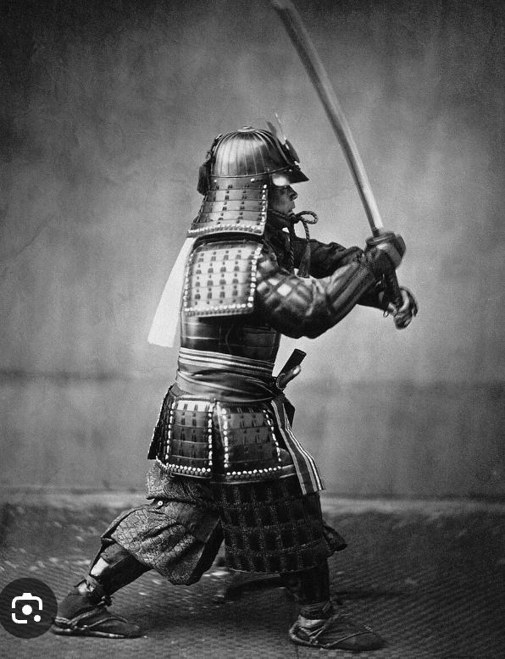

ST6: Significance Culture Knowledge (Back and now)
QTM Element: Cultural Knowledge
Activity Brief: Ancient vs. Modern Japan
Overview: Compare how samurai values persist in modern Japanese society through a visual exploration of historical armor/castles and contemporary practices.
Key Connection: From ancient samurai to modern Japanese - same values of honor, loyalty, and discipline now expressed through Kendo, Judo, business culture, and daily language like "Ganbatte."
Goal: Show cultural continuity - how ancient Japanese warrior values still shape modern Japanese identity today.
Topic 2 Step 2

Slide 9
Reference
ST1: Learn Vocabulary in Context
Gibbons, P. (2015). Scaffolding Language, Scaffolding Learning (2nd ed., p. 86). Portsmouth, NH: Heinemann.
ST2: Social Hierarchy
Gibbons, P. (2015). Scaffolding Language, Scaffolding Learning (2nd ed., pp. 85-86). Portsmouth, NH: Heinemann.
ST3: All Participants
Parsonson, B. S. (2012). Evidence-based Classroom Behaviour Management Strategies. Kairaranga, 13(1), p. 17.
"Opportunities to respond and participate...must be inclusive of all children in the class”
ST4-1: Info Collection System
Parsonson, B. S. (2012). Evidence-based Classroom Behaviour Management Strategies. Kairaranga, 13(1), pp. 17-18.
"Frequent use of praise, both verbal and non-verbal...at least four praise statements for every reprimand”
ST4-2: Rewards
Parsonson, B. S. (2012). Evidence-based Classroom Behaviour Management Strategies. Kairaranga, 13(1), p. 18.
"Class-wide incentives...Good Behaviour Game...token economies”
ST5: Culture Knowledge (East and West)
Teaching Middle Years (2024). Chapter 5: Catering for Individual Students, p. 84.
"When learning experiences capitalize on students' cultural, experiential, and personal backgrounds”
ST6: Culture Knowledge (Back and now)
Teaching Middle Years (2024). Chapter 5: Catering for Individual Students, p. 86.
“Scaffolding refers to the temporary support given to learners...scaffolding supports differentiated instruction”
Jiacheng Richard Zou
Oct 29th 2025

