Slide 1

Samurai Values Vocab Quest (Topic 2 and extension and A3)
Mr.Z
Nov 2nd, 2025

Slide 2

Core Samurai Values (Topic 2)
Pattern & Practice (Optional)
Game & Wrap-Up & SC Ticket (Activity 3)

Slide 3
Topic 02
Core Samurai Values
https://www.youtube.com/watch?v=rRFnSzxahFI

Slide 4

Love Beneath Armor
仁
The samurai's capacity for love, sympathy, and affection. True strength is not just martial prowess, but the profound power of compassion extended to all, even a defeated foe. It is the virtue that humanizes the warrior.
Jin

Slide 5
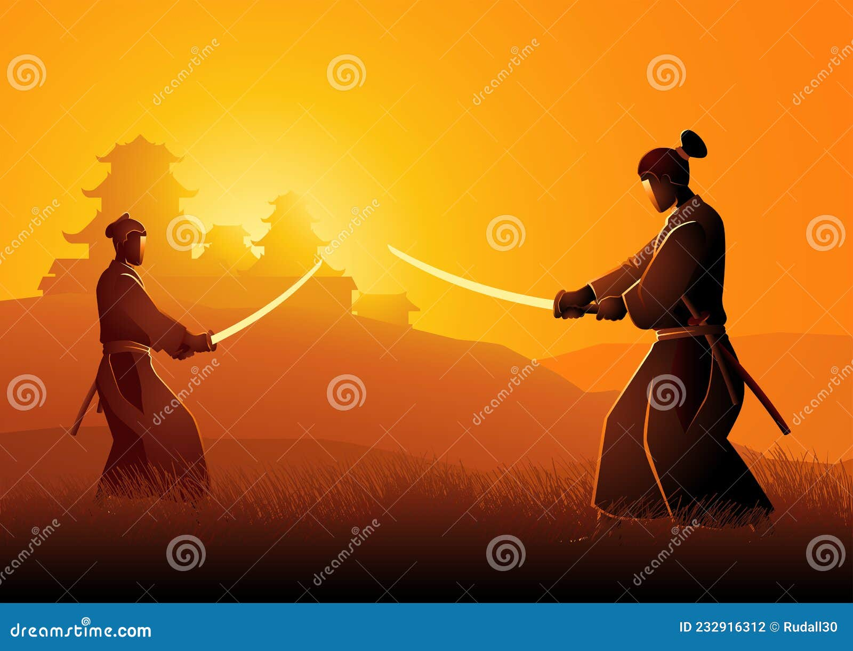
礼
Rei
Courtesy and respect are the hallmarks of a true warrior. 礼 (Rei) dictates that a samurai remains polite and dignified, even towards adversaries. This strategic virtue is both a moral compass and a tactical asset, upholding honor in every encounter.

Slide 6
勇
Yū: Heroic Courage
More than mere fearlessness, it is the valor to act rightly, even when afraid. It is the bridge between fear and recklessness.
Fear
Heroic Courage (Yū)
Recklessness
Inaction due to danger
Calculated, noble action
Action without thought

Slide 7
Personal Honor Earned
名
名 (Mei) is not given; it is earned through deeds. It is a samurai's personal dignity and the reputation they build, which defines their self-worth and the respect they command from their community.
Mei
No Honor
Eternal Honor

Slide 8
Justice as Bushidō Core (Kanji Opt)
義
義 (Gi) is the unwavering cornerstone of samurai ethics. It is the internal compass of righteousness, the standard by which all decisions are judged. To act with Gi is to be principled, fair, and incorruptible. It is the very foundation of the warrior's character.
Gi

Slide 9
The Final Virtues: A Balanced Warrior
忠
Chū
自制
Jisei
Loyalty
Self-Control
Unwavering devotion and loyalty to those under the samurai's care—be it lord, family, or comrades. It is the bond that holds society together.
The disciplined restraint to know right from wrong and to act—or refrain from acting—accordingly. It is the mastery of one's own spirit.

Slide 10
Optional
Practice
Pattern & Practice

Slide 11
Master the Pattern: Describing a Samurai
Use the sentence structure 〜は〜です (X wa Y desu) to describe a subject.
侍
は
勇敢
です。
Samurai
wa
yūkan
desu.
The samurai is brave.

Slide 12
Your Turn: Craft a Samurai Sentence
+
=
1. Pick a Samurai
2. Choose a Value
3. Create Your Sentence
Choose a figure.
Select a virtue.
Use the pattern: XはYです

Slide 13
Breakout Room Practice Protocol
Step 1: Show Card
Step 2: Make Sentence
Step 3: Switch
One student shows a vocabulary card (e.g., 勇).
Switch roles and repeat with a new word.
Partner creates a sentence: "侍は勇です。" (Samurai wa yū desu.)

Slide 14
CHAPTER.03
Game & Wrap-Up

Slide 15
Samurai Challenge
Image ID
Translation
Identify the value or item.
Match Japanese to English.
Kahoot (or the DEMO) Rules
Test your knowledge in a fast-paced game! Questions cover vocabulary, image identification, and sentence patterns. Immediate feedback and a live leaderboard will fuel your competitive spirit.
Pattern Practice
Leaderboard
Complete the sentence.
Top scores are displayed!

Slide 16
Rapid Flashcard Review
仁
礼
勇
名
Jin
Rei
Yū
Mei
義
忠
自制
Gi
Chū
Jisei

Slide 17
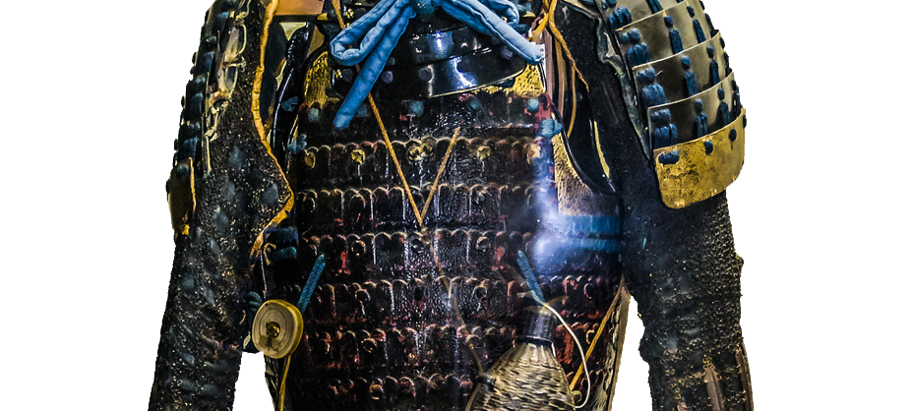
Exit Ticket
Before you go, please type one new word you learned today into the chat.
Coming Up Next...
[Your word here]
SC:
  I can identify and pronounce 5 samurai equipment terms correctly
  I can use the sentence pattern "〜は〜です" to describe samurai items
  I can recognize and explain 3 samurai values in Japanese
Next time, we'll use these powerful words to describe the lives and legends of famous samurai!
さようなら、みなさん！

Slide 18


